Slide 1
V2.3.0
New Features and Process

Slide 2
Search Invoices By SKU
This feature can be found in the sales page.
Using the same textbox for invoice searching, you can now enter a SKU and the invoices that have that item will be returned for the location you have selected.

Slide 3
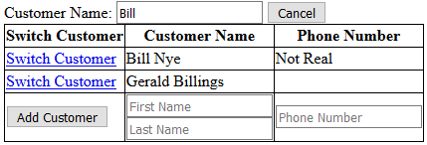
Changing Customer During a Sale
During a sale a user is now able to change the customer.
Enter the customer you are searching for in the Customer Name field.
Click on the Select Different Customer button.
A list of all matching customers will be displayed.
Click on Switch Customer beside the customer you want to use.
Or click cancel to keep the current customer on the sale.

Slide 4
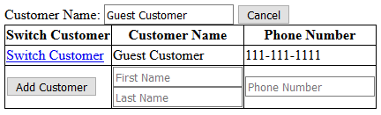
Adding a Customer During a Sale
During a sale a user is now able to add a new customer to the database and have the current sale attributed to the new customer.
At any time during a sale click on the Select Different Customer button.
At the bottom of the customer search will be text boxes to enter a first name and last name of the customer.
The First and Last name fields are required the Phone Number field is not.
Click on the Add Customer button and the new customer will be added to the database.
Please always make sure that you have searched for the customer first before adding them to the database as this will prevent duplicate customers being created.

Slide 5

Searching For Customers and Items
When you make a search for either customers or items, the list will be broken up into 25 rows per page.
This was added to allow easier navigation when searching for an item in a big list.
To change between pages, press the numbered buttons at the bottom of the list.

Slide 6
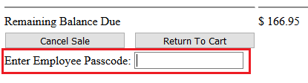
Changes in Processing Sales
Before a sale can be processed, the user must now enter their employee passcode in the checkout screen.
The textbox for doing that is located near the bottom of the page.
Please Note:
All employees will now need to be setup with a passcode.
Sales can also only be completed with a passcode from an employee that is listed as Sales Staff.
No Admin passcodes will process sales.

Slide 7
Adding Customers to Email List
If you want to add a customer to the email list, create the customer or go to their profile page and press Edit Customer.
Next the email textbox is a checkbox for adding the customer to the email list.

Slide 8
Export – Email List
To go along with the ability of adding customers to an email list, a new export has been created.
You will find this under the Settings header in the Export Items To Excel section.
The information exported is the first, and last name, and the customer’s email address.

Slide 9
Viewing Invoices On Customer Profiles
When you view a customer’s profile, you now see all invoices that are associated with them.

Slide 10
Bug Fixes
Return process is now showing the current date instead of the original sale date.
When completing a return the amount to refund to customer was being calculated as an integer (whole number rounding down). It has now been corrected to calculate as a double (allows decimals).
Cancel button on the TradeIn page no longer requires any validation, so it now actually works.

Slide 11
Minor Updates/Changes
Returns now show up on the homepage.
Invoices now have a timestamp.
Sales Home Page default button has now been changed to the invoice search (pressing enter on keyboard).
The Change Calculator on the Checkout screen when making a sale using cash has now been given a title to more readily identify it’s function (enter the cash tendered to calculate the change due).

